Slide 1
Conducted EMI results from CFL
Ver1.1
20-03-2014

Slide 2
Configuration Parameters for SA
Signal analyser N9000A Agilent 9Khz-7.5Ghz
Input freq. range : 10Khz-1Mhz
CF step size : 99Khz
Residual BW: 30Hz
Video BW : 30Hz
VBW: 3-dB RBW : 1.0
Span: 106
RBW Control[Gaussian, -3dB]
Sweep ~274ms [FFT : 1001Pts]
Attenuation: 0.00dB
AMPTD Y ref: -40dBm
*BW Bandwidth

Slide 3
Hardware modifications
HF probes Tektronix 20Mhz Input impedance of 1Mohm are used now.
Earlier 2 CFL lights were connected as a bunch now only one to identify individual signature.

Slide 4
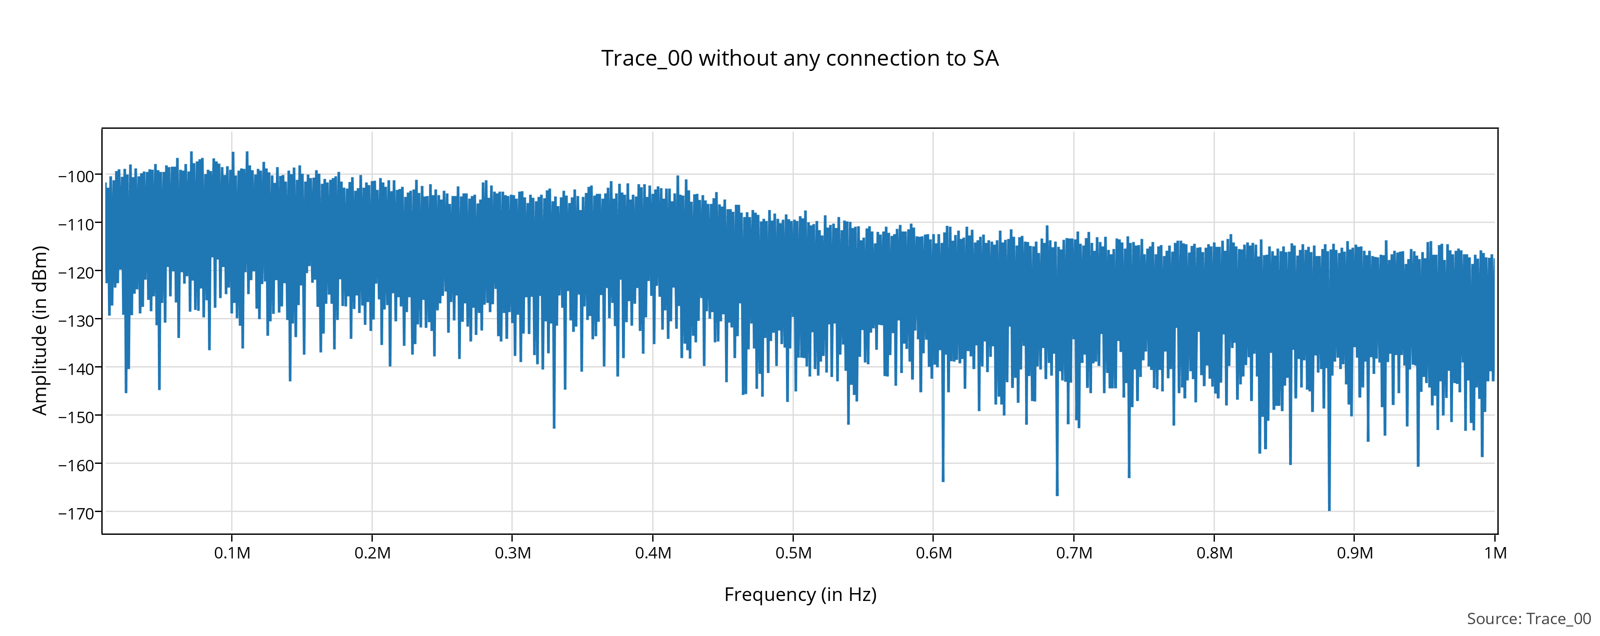
Test_00

Slide 5
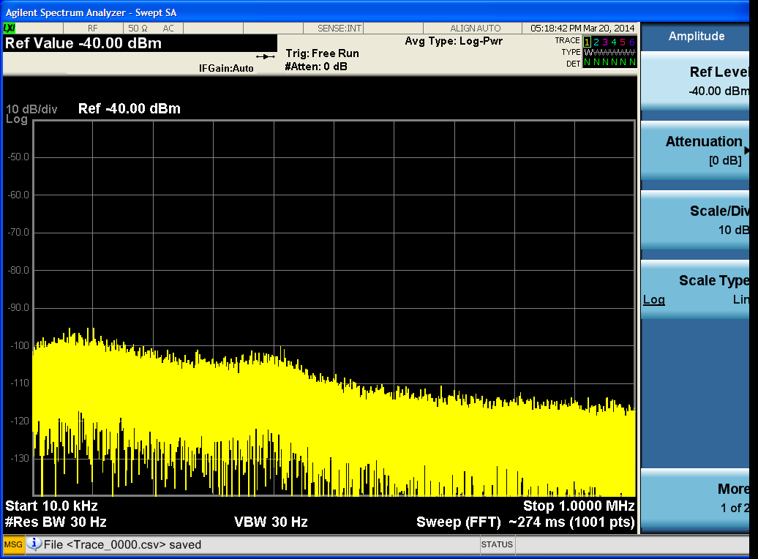
Test_00

Slide 6
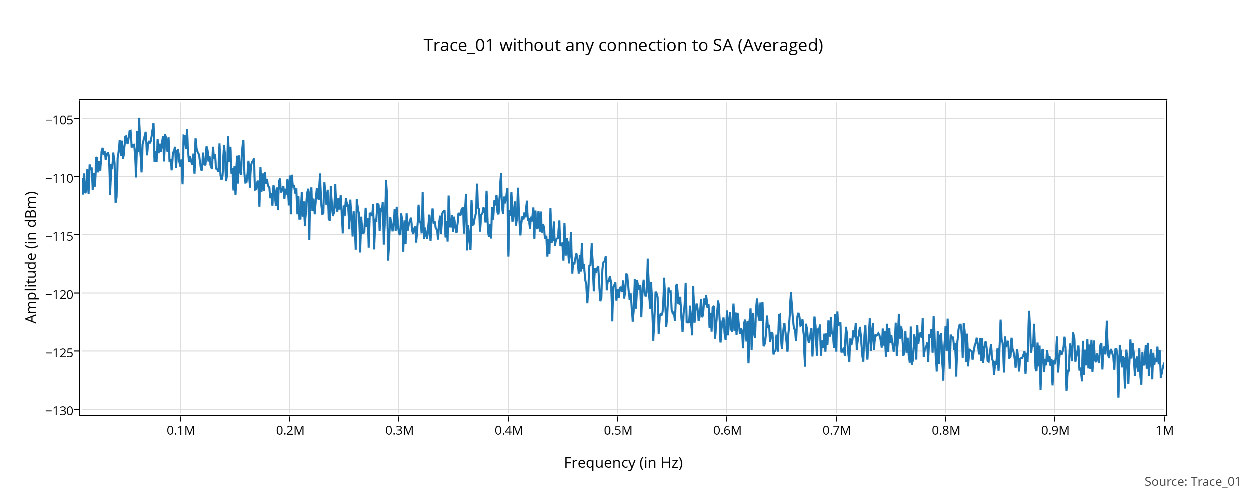
Test_01

Slide 7
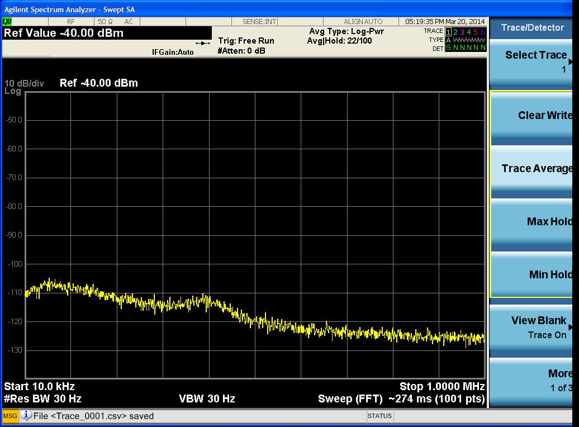
Test_01

Slide 8
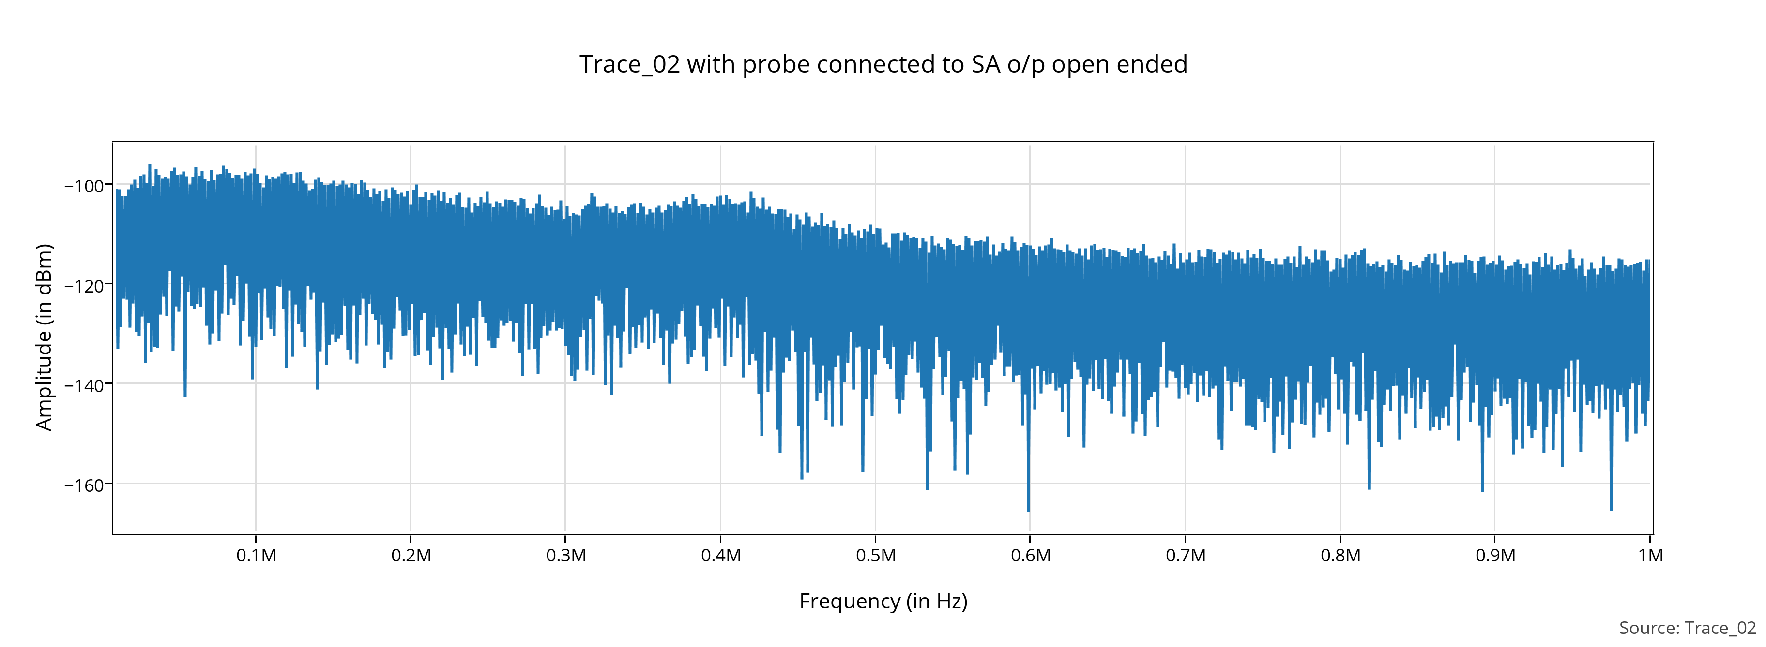
Test_02

Slide 9
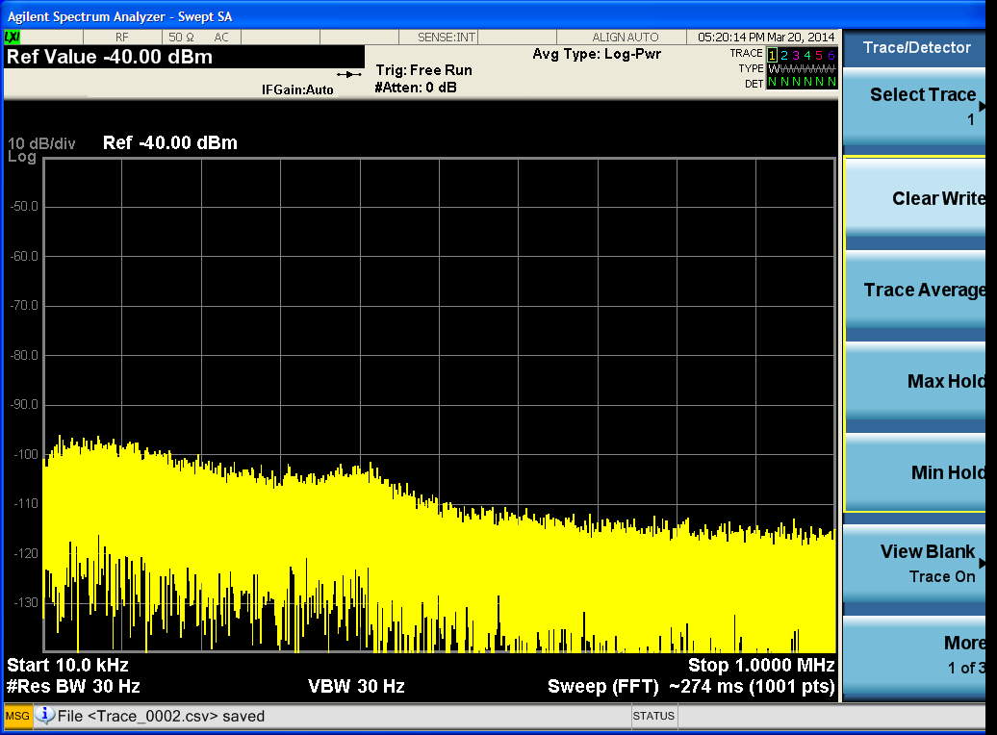
Test_02

Slide 10
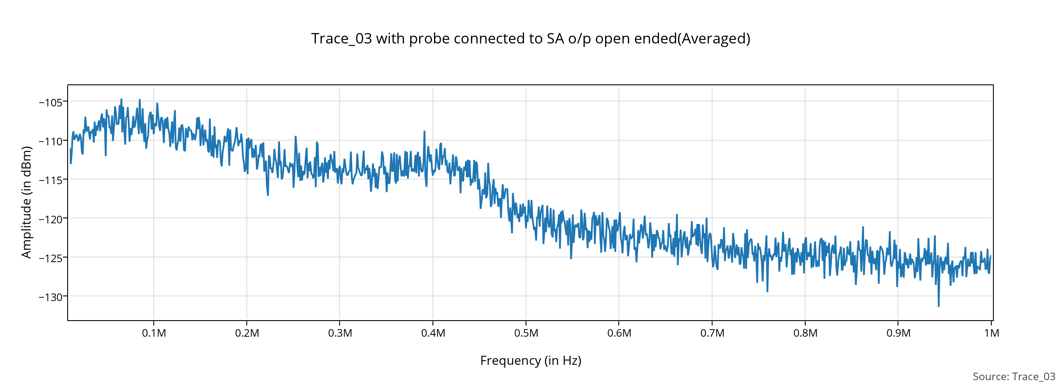
Test_03

Slide 11
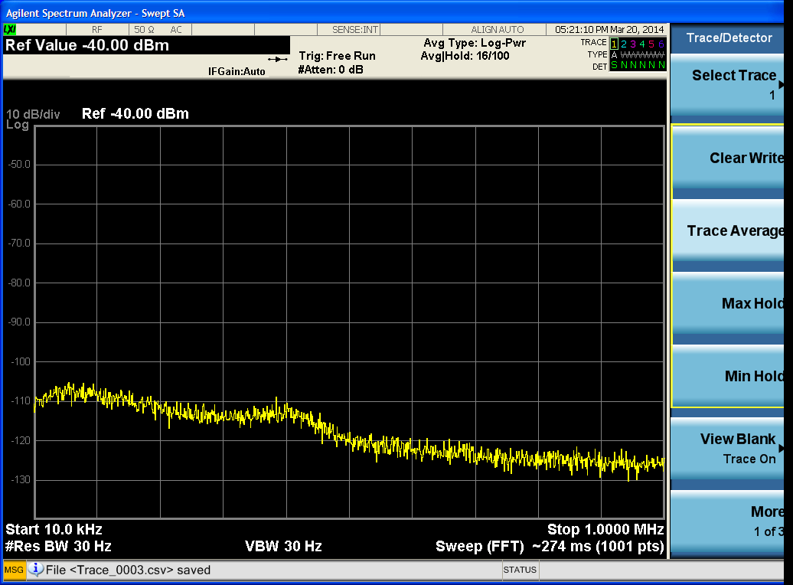
Test_03

Slide 12
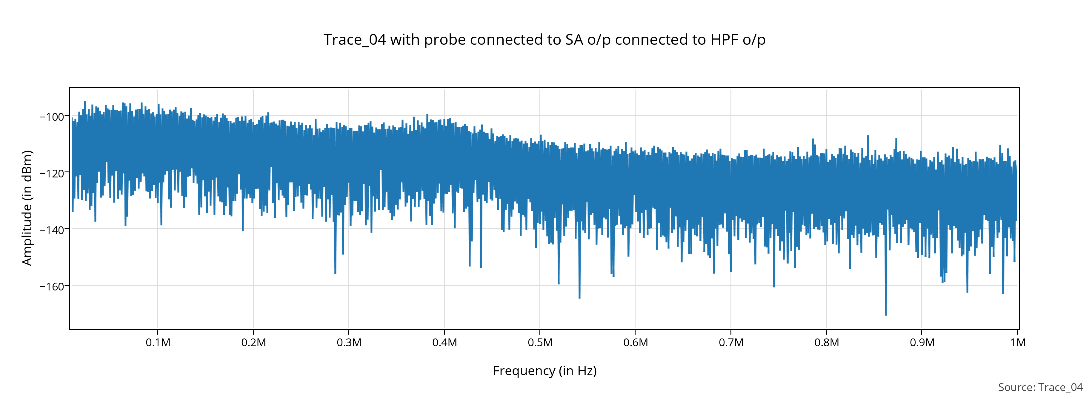
Test_04

Slide 13

Test_04

Slide 14
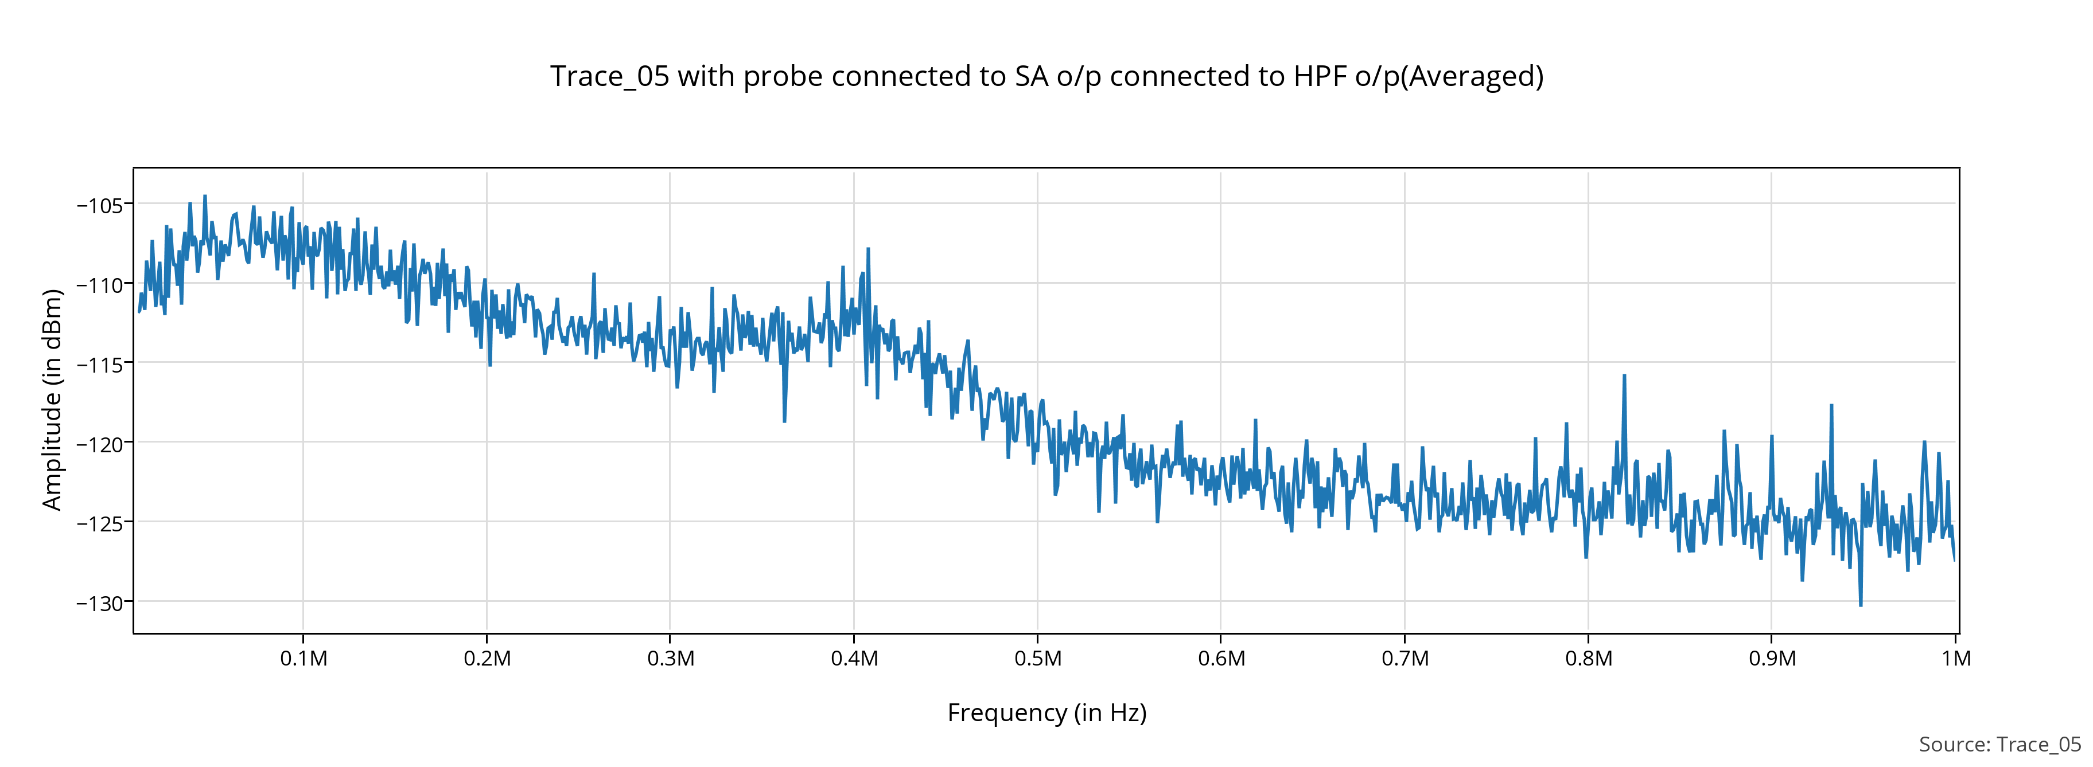
Test_05

Slide 15
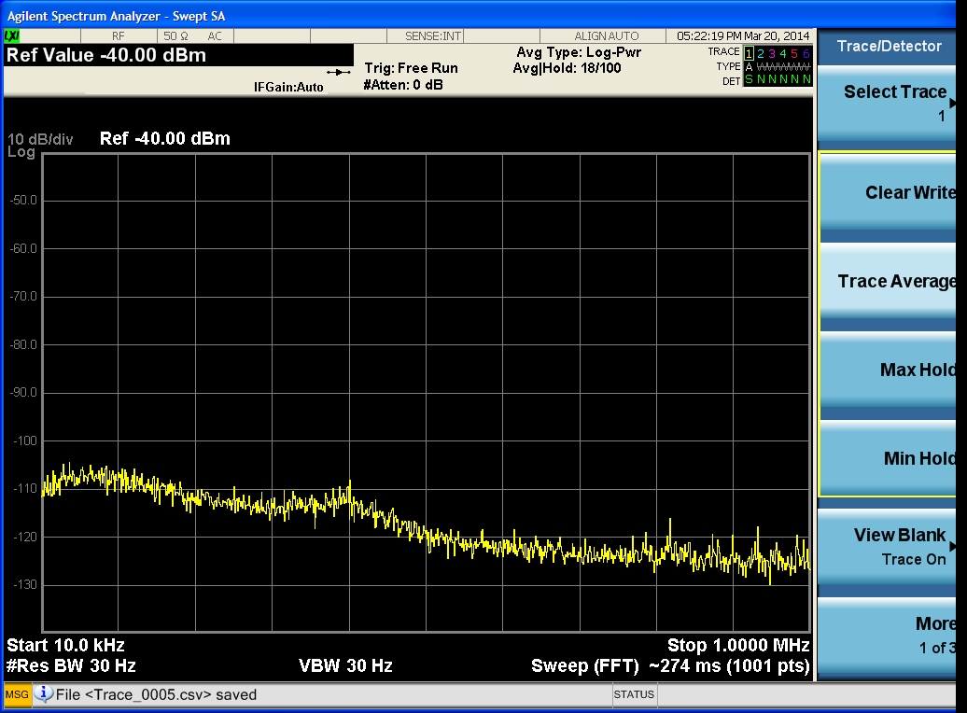
Test_05

Slide 16
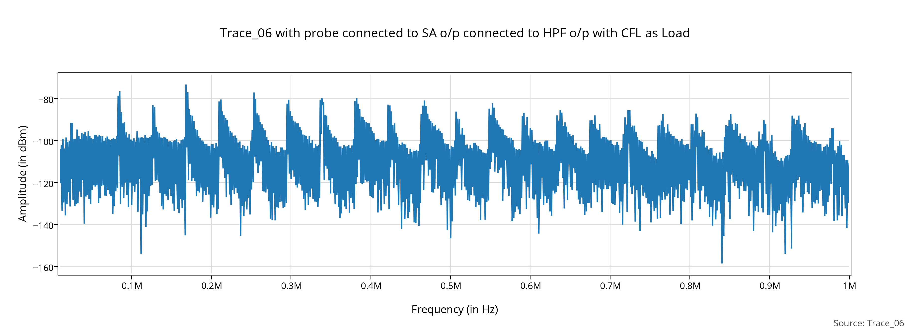
Test_06

Slide 17
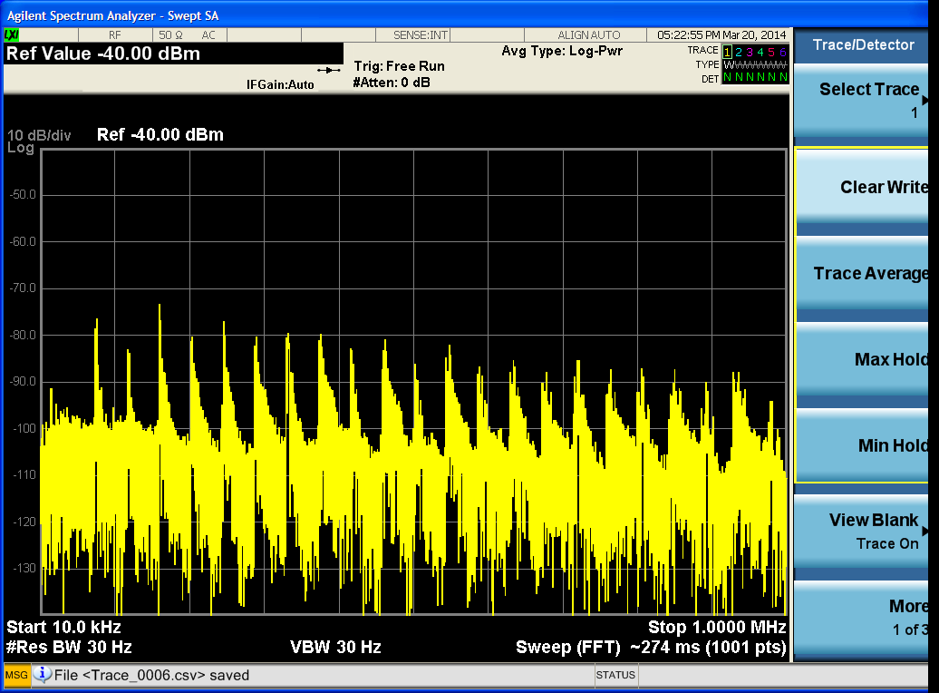
Test_06

Slide 18
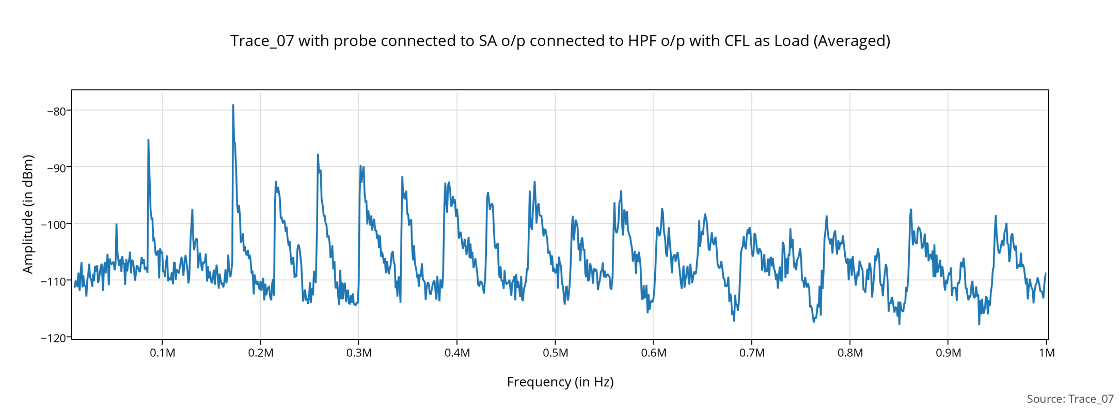
Test_07

Slide 19
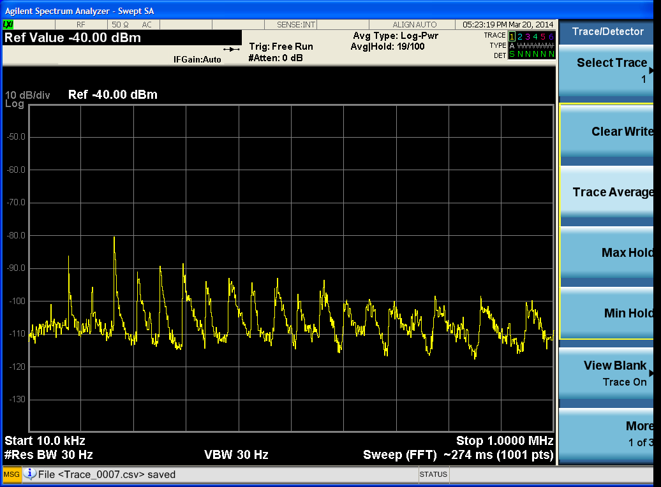
Test_07

Slide 20
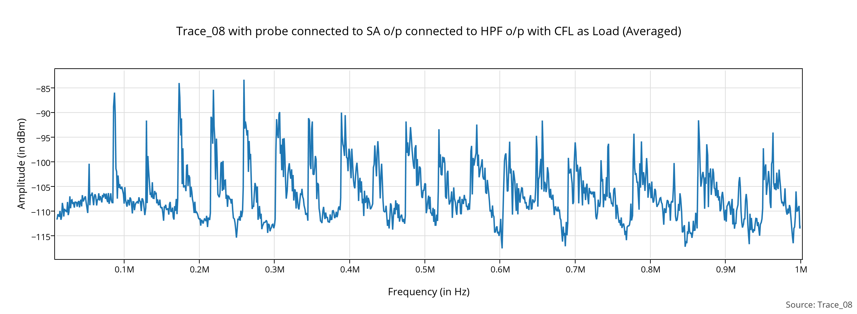
Test_08

Slide 21
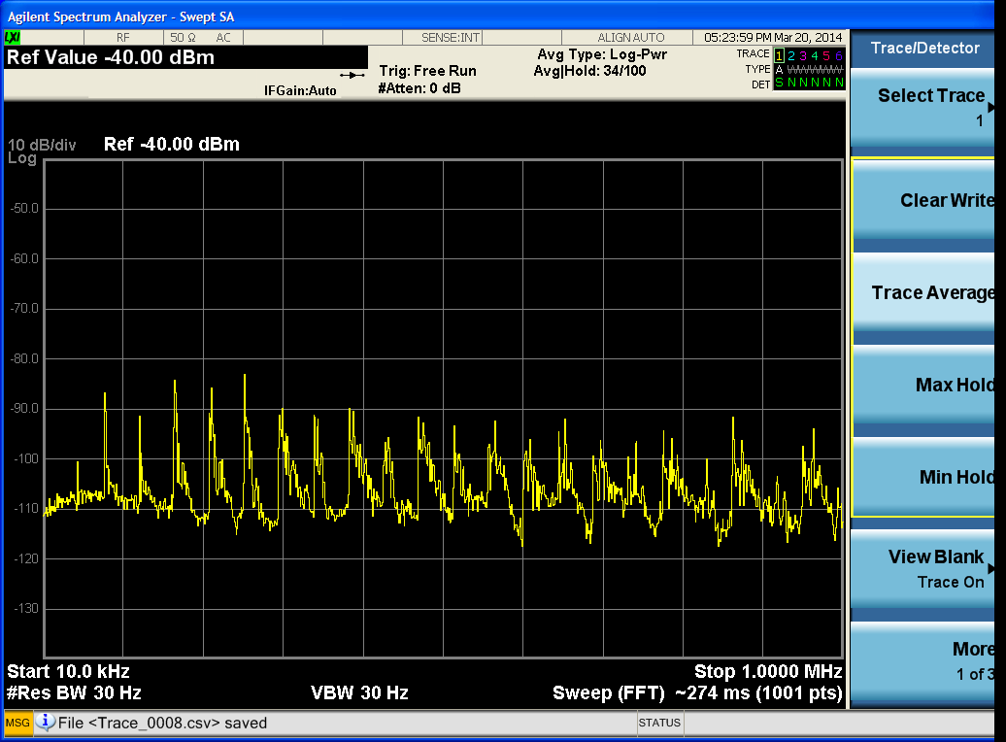
Test_08

